Slide 1

Introduction
Realization
Application
Requirements
Conclusions
Alarm System
Fedy Haj Ali
Daniela Koreta
Real-Time Embedded Systems
A.A. 2020-2021

Slide 2
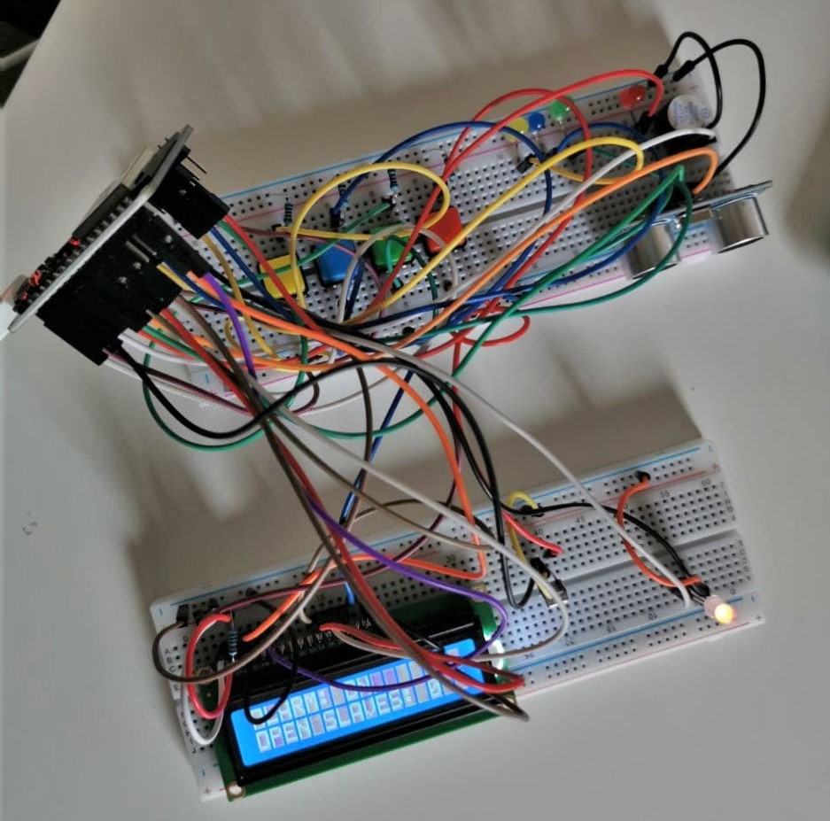
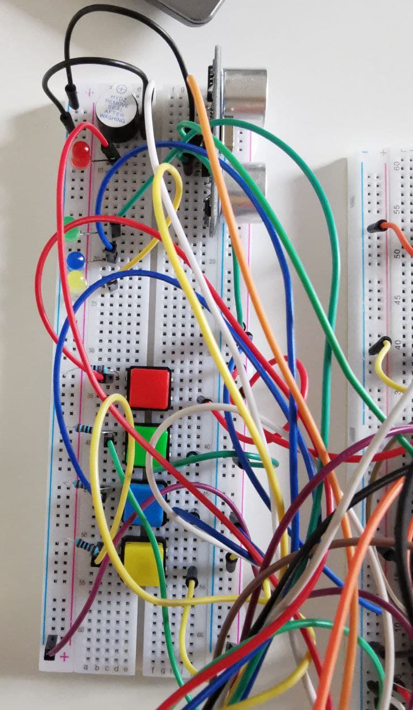
Introduction
Realization
Application
Requirements
Conclusions
About This PRoject
The project’s aim is to simulate the functioning of an alarm system through the detection of movements and the tracking of the opened windows/doors simulated by hardware components.

Slide 3






Introduction
Realization
Application
Requirements
Conclusions
software
tools

Slide 4
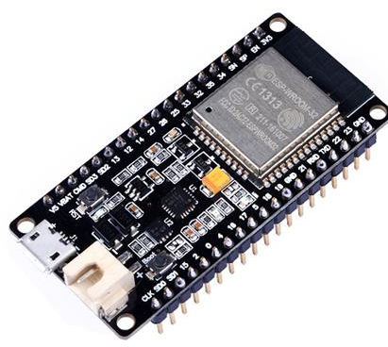
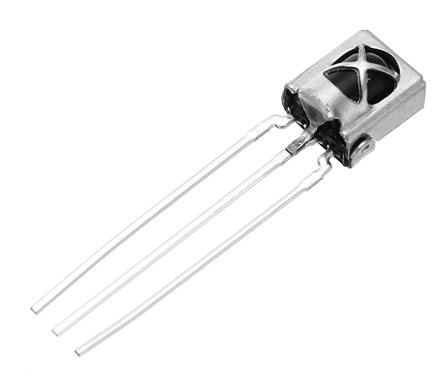
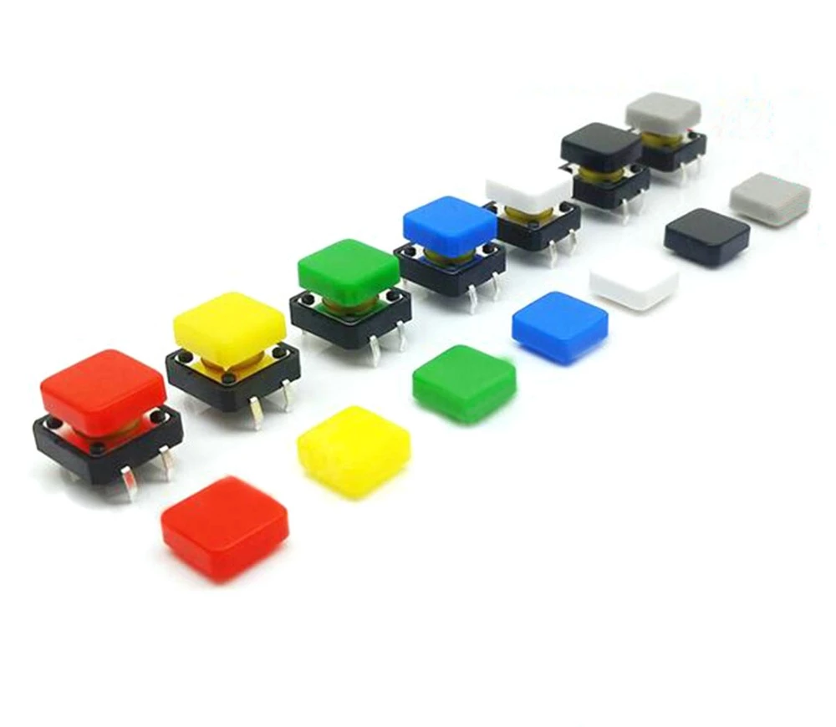
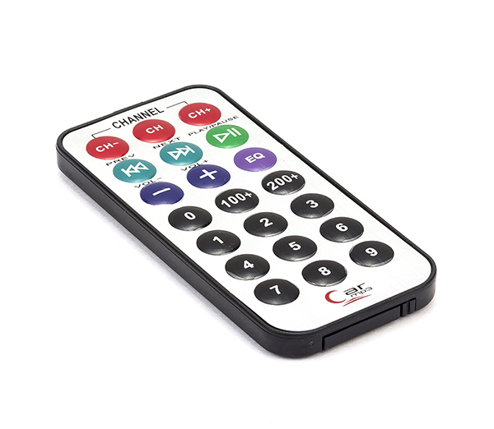
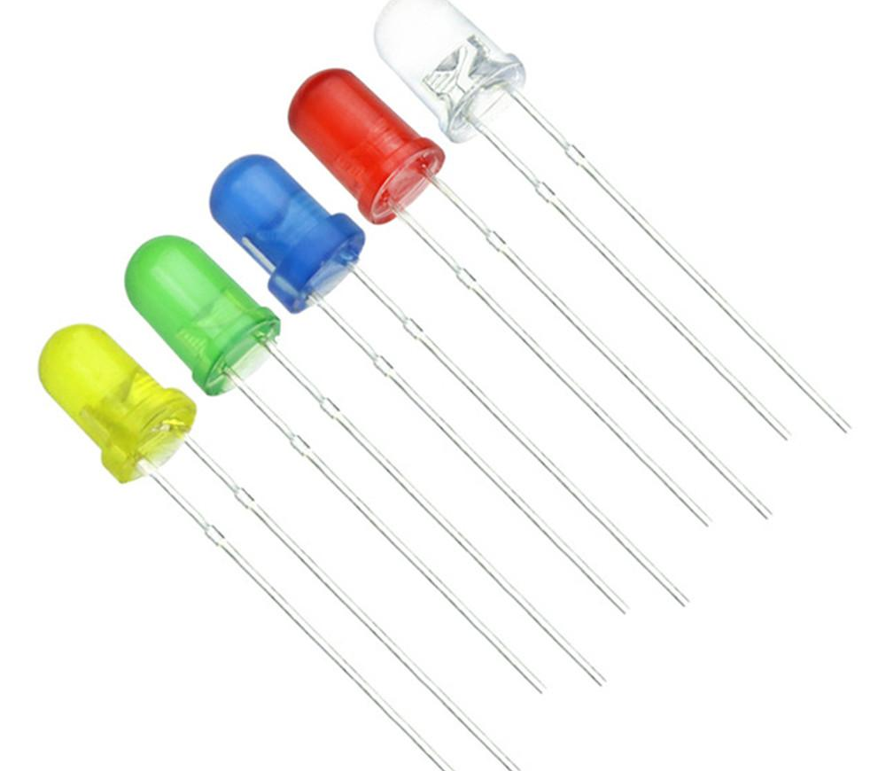
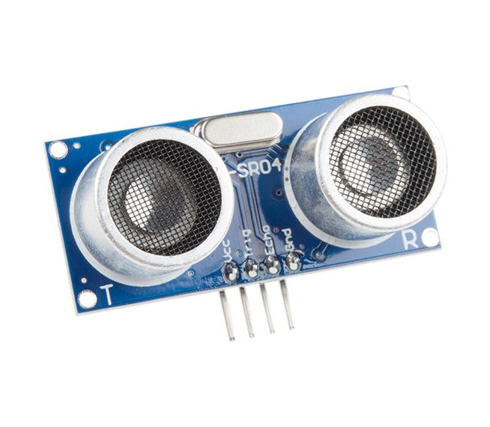
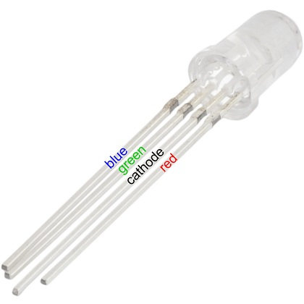
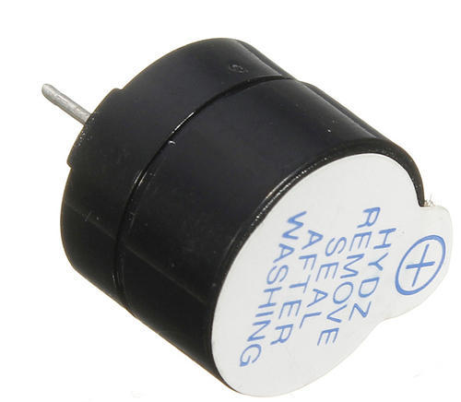
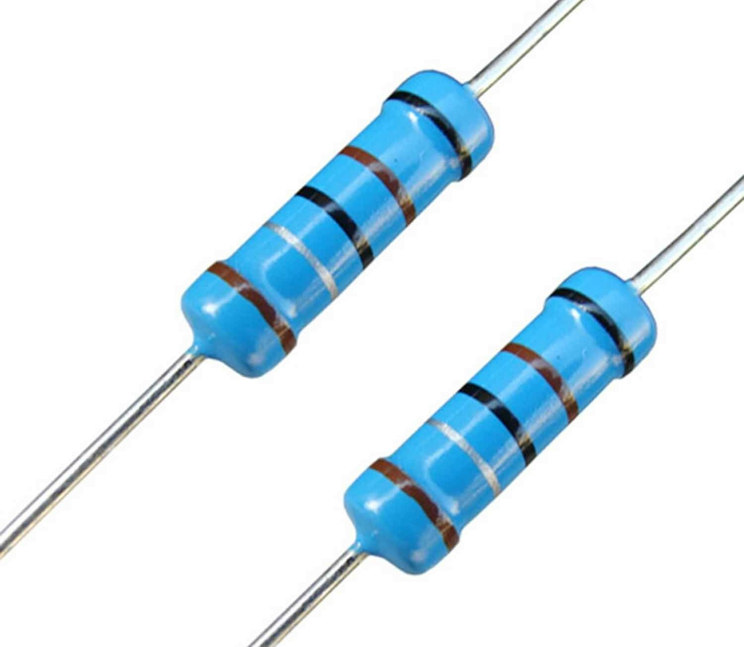
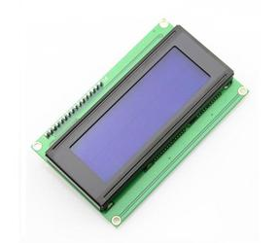
Introduction
Realization
Application
Requirements
Conclusions
Hardware Components
esp32
infrared
receiver
buttons
remote
control
leds
ultrasonic
sensor
led RGB
buzzer
resistors
display lcd
16x02

Slide 5
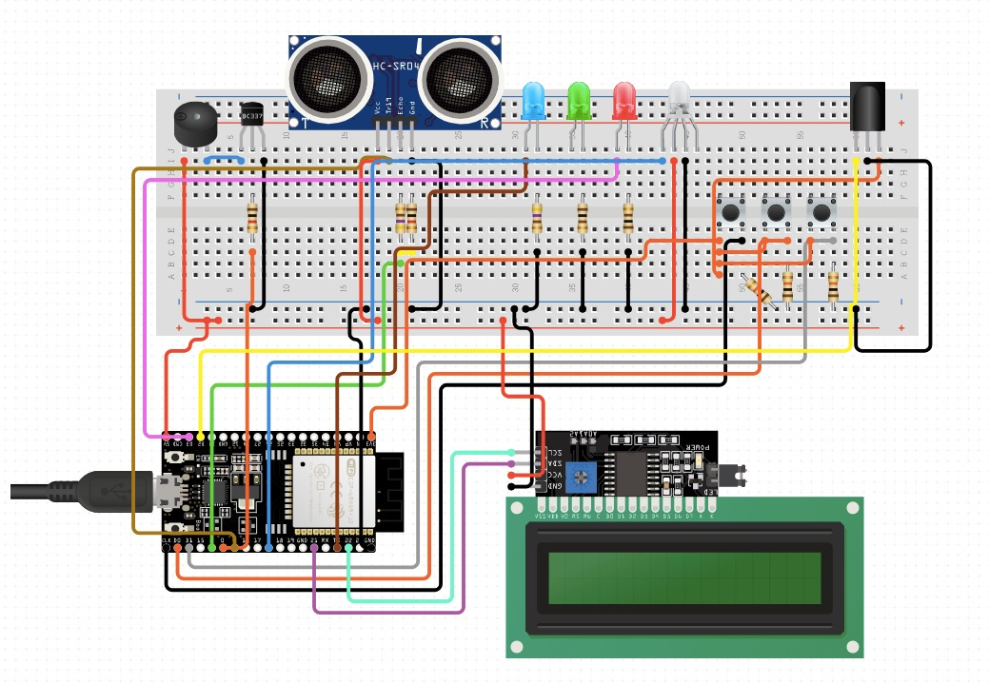
Introduction
Realization
Application
Requirements
Conclusions
Circuit Schematics

Slide 6
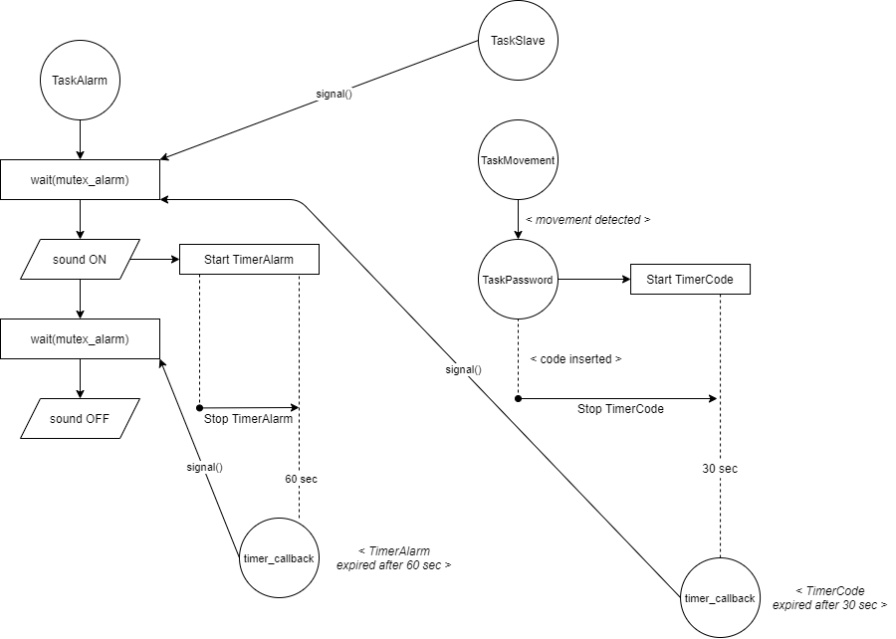
Introduction
Realization
Application
Requirements
Conclusions
Syncrhonization

Slide 7
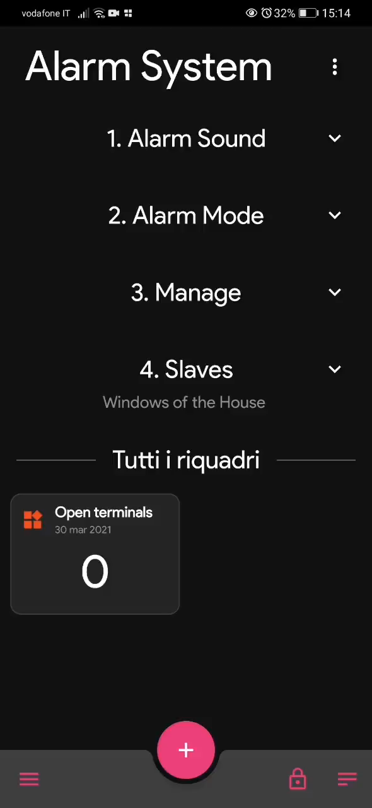
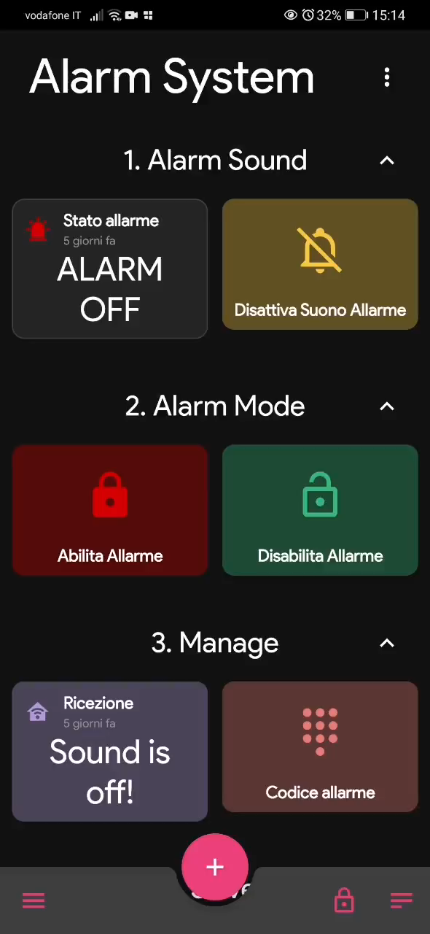
Introduction
Realization
Application
Requirements
Conclusions
MQTT

Slide 8
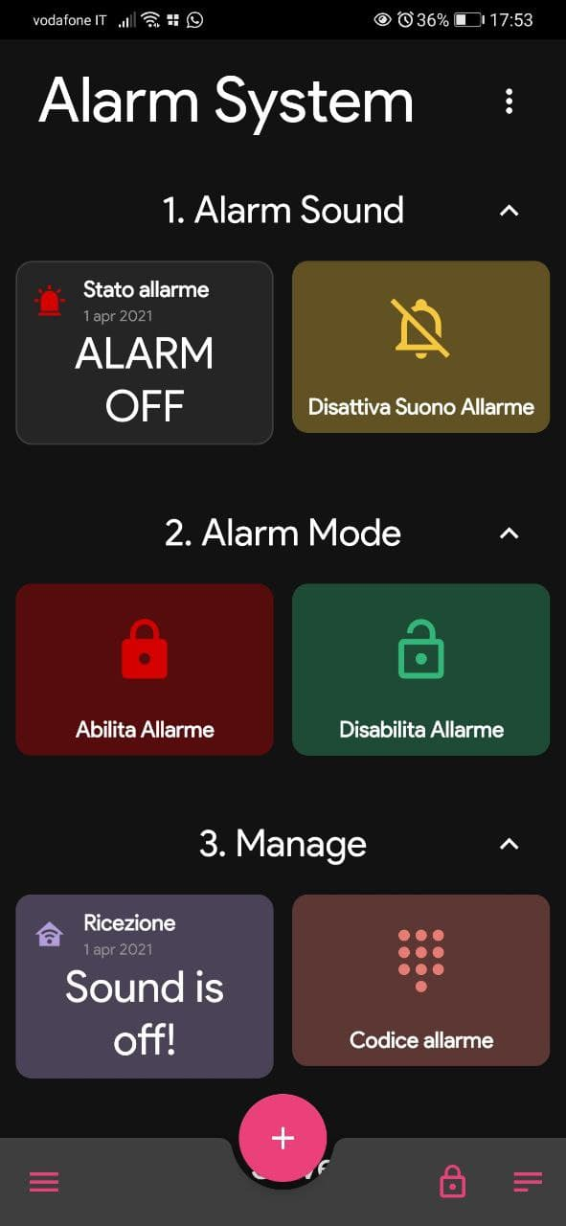
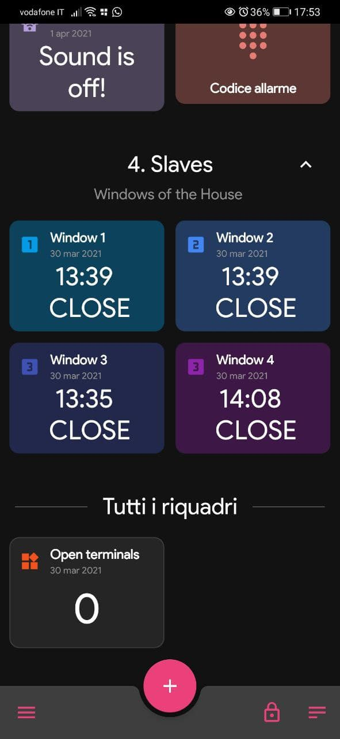
Introduction
Realization
Application
Requirements
Conclusions
MQTT

Slide 9
Introduction
Realization
Application
Requirements
Conclusions
IFTTT

Slide 10
Introduction
Realization
Application
Requirements
Conclusions
Application Requirements
Channels:
1x ultrasonic sensor, 3x buttons, 4x leds, 1x buzzer, 1x infrared receiver
1 task per input/output channel:
TaskMovement, TaskDisplay, TaskAlarm, TaskSlaves,
TaskSetAlarmButton, TaskPassword, TaskMain
≥ 3 input channels:
remote control, app, ultrasonic sensor, buttons
≥ 2 sensor devices or 1 sensor device + 1 network device:
infrared sensor, ultrasonic sensor, integrated Wi-Fi
≥ 2 output channels:
buzzer, app, display 16x02, leds, led RGB
≥ 1 many-to-one task communication:
communication between the Alarm System and the Application through TaskMain

Slide 11
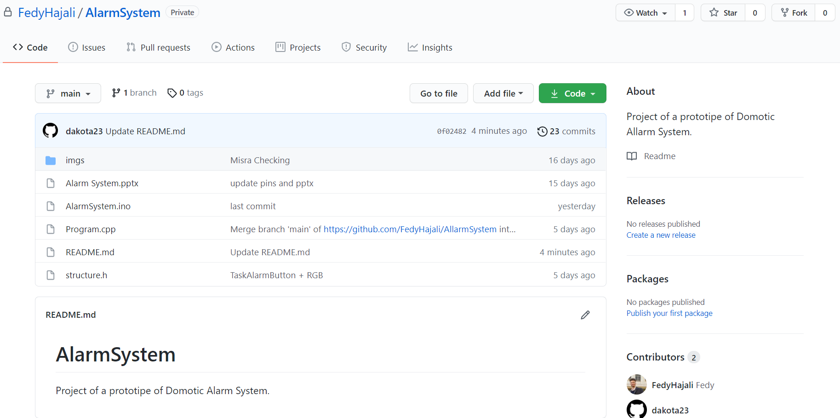
Introduction
Realization
Application
Requirements
Conclusions
Easy Requirements
Git Versioning

Slide 12
Introduction
Realization
Application
Requirements
Conclusions
Easy Requirements
Task WCET analysis measurement-based
TASK | PERIOD (ms) | WCET (ms) | CORE
TaskSlave | 500 | 4 | 0
TaskSetAlarmButton | 500 | 3 | 0
TaskMain | 1000 | 500 | 1
TaskMovement | 2000 | 1000 | 1
TaskDisplay | 2000 | 8 | 1
TaskPassword | 500 | 5 | 1

Slide 13
Introduction
Realization
Application
Requirements
Conclusions
Easy Requirements
Period execution (timer-based tasks)
core 0 – period 500 ms
Slave1
Slave2
Slave3
SetAlarm

Slide 14
Introduction
Realization
Application
Requirements
Conclusions
Easy Requirements
Period execution (timer-based tasks)
core 1 – period 500 ms

Slide 15

Introduction
Realization
Application
Requirements
Conclusions
Challenging Requirements
MISRA-C Compliance
cppcheck → analysis tool
addons → misra.py
misra.py → MISRA-C compliance validation
MISRA-C → guidelines set for embedded systems
cppcheck –addon = misra.py somefile.c

Slide 16

Introduction
Realization
Application
Requirements
Conclusions
before
n. rule | rule description | classification | complied
2.7 | There should be no unused parameters in functions | Advisory
7.3 | The lowercase character 'l' shall not be used in a literal suffix | Required
8.11 | When an array with external linkage is declared, its size should be explicitly specified | Advisory
11.6 | A cast shall not be performed between pointer to void and an arithmetic type | Required
12.1 | The precedence of operators within expressions should be made explicit | Advisory
14.4 | The controlling expression of an if statement and the controlling expression of an iteration-statement shall have essentially Boolean type | Required
16.3 | An unconditional break statement shall terminate every switch-clause | Required
17.7 | The value returned by a function having non-void return type shall be used | Required
20.1 | #include directives should only be preceded by preprocessor directives or comments | Advisory

Slide 17

Introduction
Realization
Application
Requirements
Conclusions
after
n. rule | rule description | classification | complied
2.7 | There should be no unused parameters in functions | Advisory
7.3 | The lowercase character 'l' shall not be used in a literal suffix | Required
8.11 | When an array with external linkage is declared, its size should be explicitly specified | Advisory
11.6 | A cast shall not be performed between pointer to void and an arithmetic type | Required
12.1 | The precedence of operators within expressions should be made explicit | Advisory
14.4 | The controlling expression of an if statement and the controlling expression of an iteration-statement shall have essentially Boolean type | Required
16.3 | An unconditional break statement shall terminate every switch-clause | Required
17.7 | The value returned by a function having non-void return type shall be used | Required
20.1 | #include directives should only be preceded by preprocessor directives or comments | Advisory

Slide 18
Introduction
Realization
Application
Requirements
Conclusions
Future Improvements
NOW
THEN
Pulsanti → REED
Sensore HC → PIR
ESP32 → ESP32 CAM
Broker public → private

Slide 19
Introduction
Realization
Application
Requirements
Conclusions
What we have learned

